Slide 1

PP
POVERTY AND TERRORISM
FOVERTY AND TERRORISM
PREPARED BY BETHLEHEM BOGALE
PREPARED BY BETHLEHEM BOGALE

Slide 2
TOPIC
WHAT IS POVERTY AND TERRORISM?
HOW POVERTY AND TERRORISM ARE INTERRELATED?
IMPACT OF TERRORISM IN DEVELOPING COUNTRIES?

Slide 3
INTRODUCTION
Terrorism is an act of illegal action in a country which create a massive destruction in a facility and innocent people can be killed. Terrorism indirectly affect the economy and market un certainty.
TERRORISM WE HAVE TWO TYPES OF TERRORISM
DOMESTIC AND INTERTATIONAL
DOMESTIC TERRORISM IS ABOUT VIOLENCE IN CIVILIAN POPULATION.
INTERNATIONAL TERRORISM DEALS WITH ATTACKS ON INTERNATIONAL ORGANIZATIONS LIKE SEP 9/11
Poverty is Lack of getting basic human needs which is food, shelter and cloth. Poverty has also negative impact on unable to get enough work and medication,

Slide 4
Data
COUNTRY | PER CAPITAL GNI (US$) | HDI RANKING | NUMBER OF INCIDENTS 2012
Algeria | 7418 | 93 | 15
Angola | 4812 | 148 | 0
Burundi | 544 | 178 | 8
Chad | 1258 | 184 | 0
Congo | 319 | 186 | 16
Cote d'Ivoire | 1593 | 168 | 3
Djibouti | 2350 | 164 | 0
Egypt | 5401 | 112 | 18
Eritrea | 531 | 181 | 1
Ethiopia | 1017 | 173 | 3
Kenya | 1541 | 145 | 41
Liberia | 480 | 174 | 0
Libia | 13765 | 64 | 2
Madagscar | 828 | 151 | 1
Mauritania | 2174 | 155 | 3
Morocco | 4384 | 130 | 1
Mozambique | 906 | 185 | 0
Namibia | 5973 | 128 | 0
Niger | 701 | 186 | 2
Nigeria | 2102 | 153 | 173
Sierra Leone | 881 | 177 | 0
somalia | No information listed | No information listed | 184
South Africa | 9594 | 121 | 0
Sudan | 1848 | 171 | 38
Tunisia | 8103 | 94 | 3
Uganda | 1168 | 161 | 0
Zimbabwe | 424 | No information listed | 1

Slide 5
Data count
VARIABLES IN THE DATASETS ARE
COUNTRY NAME
GNI PER CAPITAL(US)
HDI( HUMAN DEVELOPMENT INDEX)
NUMBER OF INCIDENTS

Slide 6
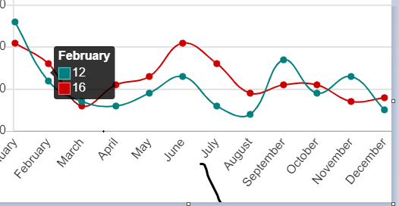
Niger (18 attacks)
Where Boko Haram attacked in 2016
Nigeria (80 attacks)
Cameroon (26 attacks)
Chad (3 attacks)

Slide 7
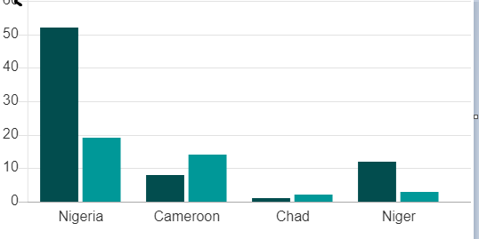
THE BOKHARM ATTACK IN THE 2016
Fatalities increase, targets remain the same
At least 967 people were reportedly killed by Boko Haram attacks in 2017, an increase on the previous year when 910 deaths were reported.

Slide 8
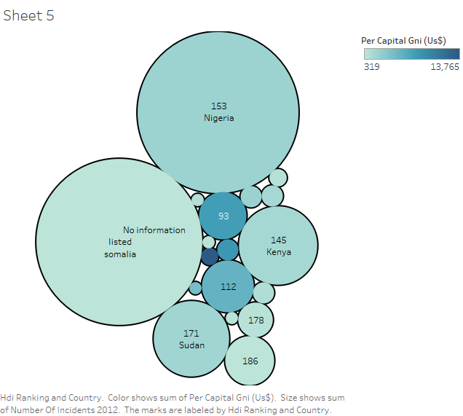
EXPLANATORY DATA ANAYSIS

Slide 9
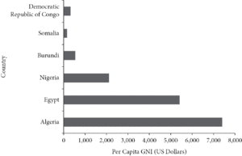
ANALYSIS

Slide 10
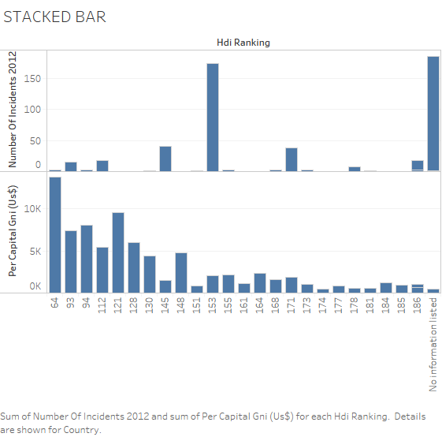
Explanatory data analysis

Slide 11
CONCLUSION
BASED ON THE REASEARCH I MADE TERRORISM HAS A BIG IMPACT DEVELOPING COUNTRIESON
.Temporary border controls
STRONG SECURITY AIR TRANSPRTATION
Stepping up the exchange of information. A LOT OF COUNTRIES ARE AGREEING TO GIVE TERRORIST . AS A RESULT THEY CAN’T MOVE FREELY IN DIFFERENT COUNTRIES
.INTERPOL IS PLAYING A GREAT ROLE

Slide 12
REFERENCE
Terrorism overshadows internal conflicts | Africa Renewal. June 16, 2019
https://www.un.org/africarenewal/magazine/april-2016/terrorism-overshadows-internal-conflicts
Abadie, A. (2004). Poverty, Political Freedom, and The roots of Terrorism National Bureau of Economic Research Working Paper 10859, Cambridge, MA.
Abrahamsen, R. (2004). A breeding ground for terrorists? Africa and Britain’s war on terrorism. Review of African Political Economy, 31:677–684.
Arce, D.G., and Sandler, T.(2009). Fitting in: group effects and the evolution of fundamentalism. Journal of Policy Modeling, 31:739–757.
Barros, C.P., Faria, J.R., and Gil-Alana, L.A. (2008). Terrorism against American citizens in Africa: related to poverty? Journal of Policy Modeling 30:55–69.

Slide 13
THANK YOU FOR LISTENING

